Slide 1

SchoolKit for Congo
Equipping education,
providing dignity and homes.
Penny Vos 24/9/23

Slide 4
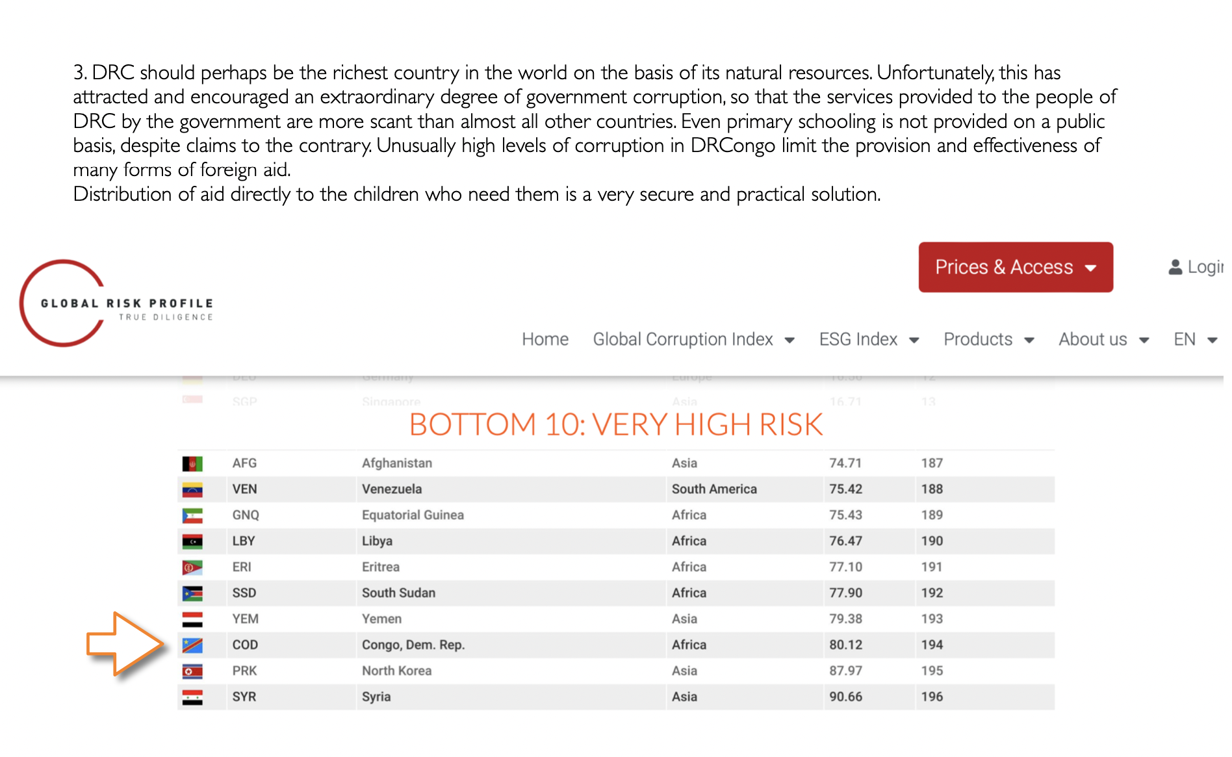

Slide 6
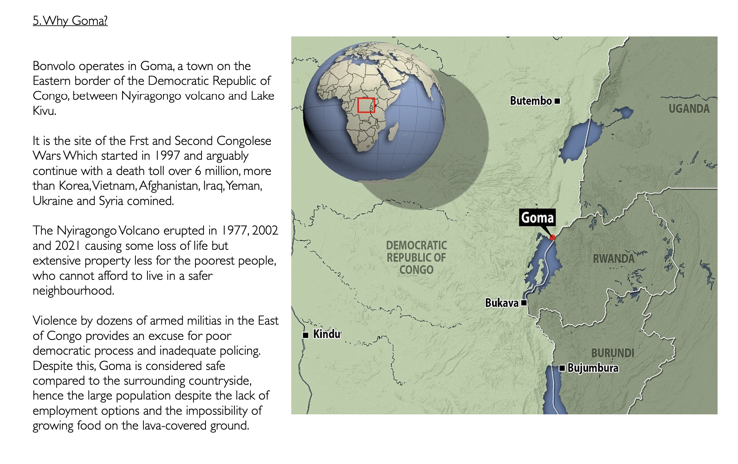

Slide 7
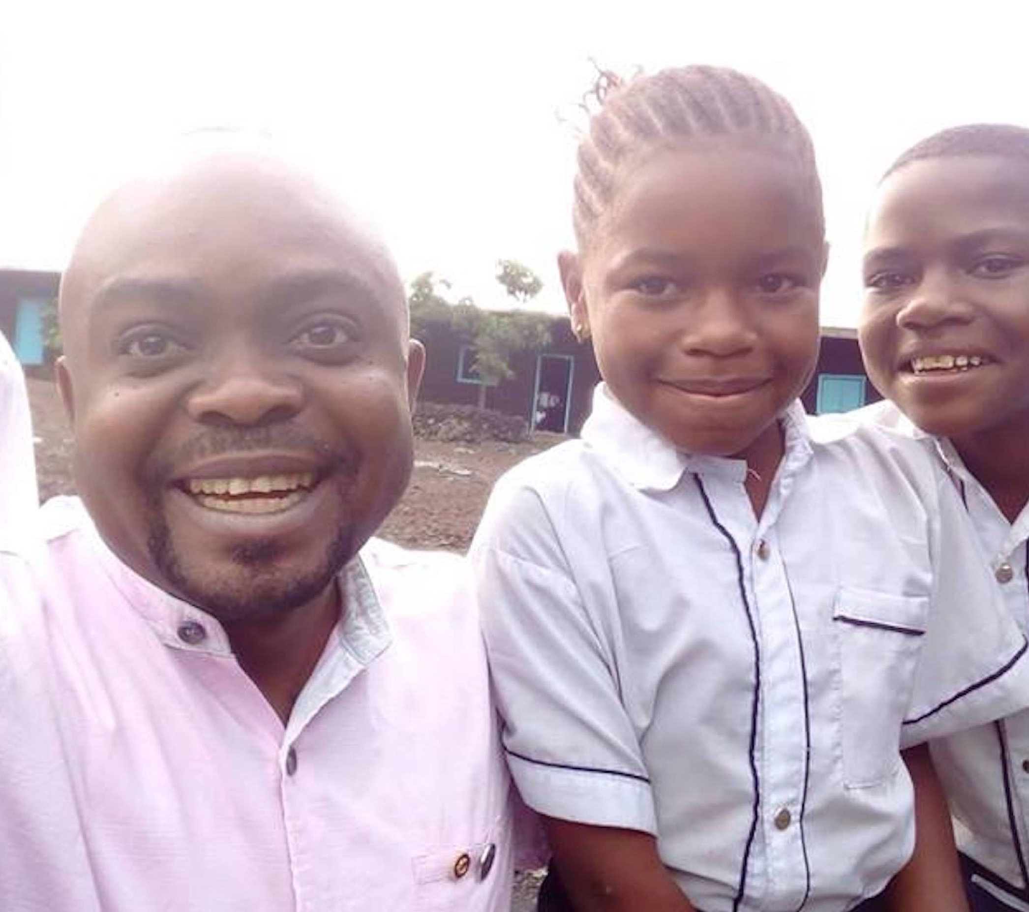
Solidareca Bonvolo
is a charity, founded in 2004 in Goma, DRCongo, to find sponsors so that orphan children could go to school.

Slide 8
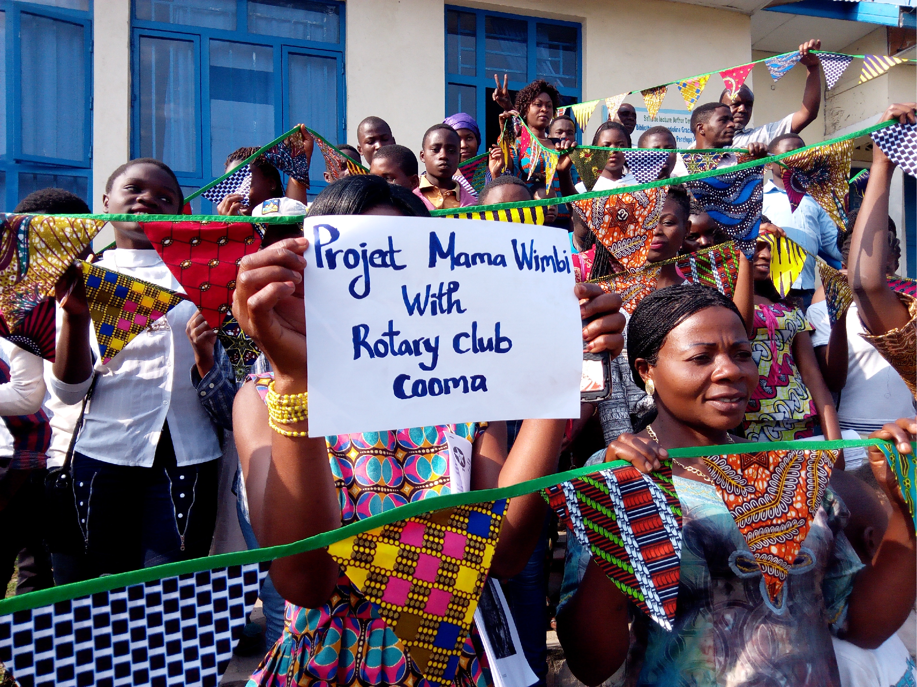
Mama Wimbi 2018

Slide 9
Up-Skilling
Making Uniforms
As the team gained skills, they applied them to making school uniforms.
Even very poor people need uniforms because no-one is allowed to attend school without one.
The quality rose, but the work barely doubled the fabric value. It helped pay school fees but could not help with the rent, for team members or the workshop!

Slide 10
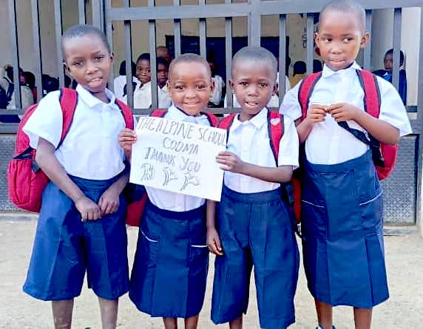


Slide 12
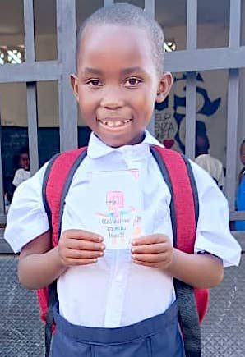
Tiny StoryBooks
With a twist!

Slide 13
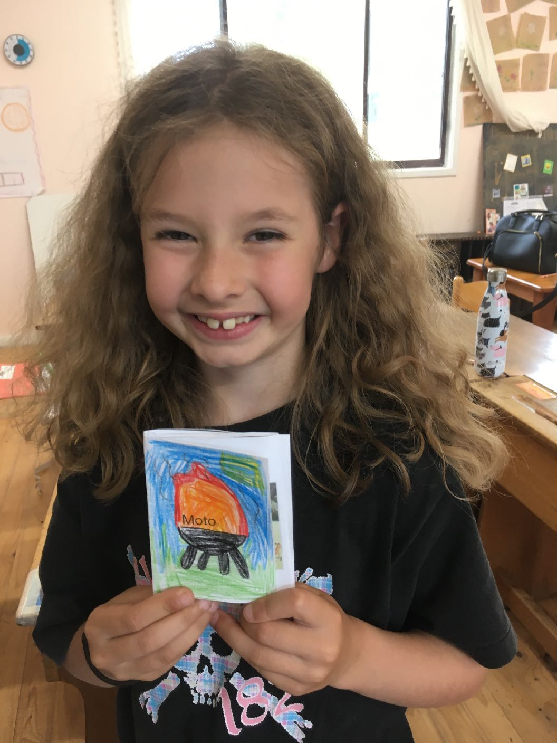
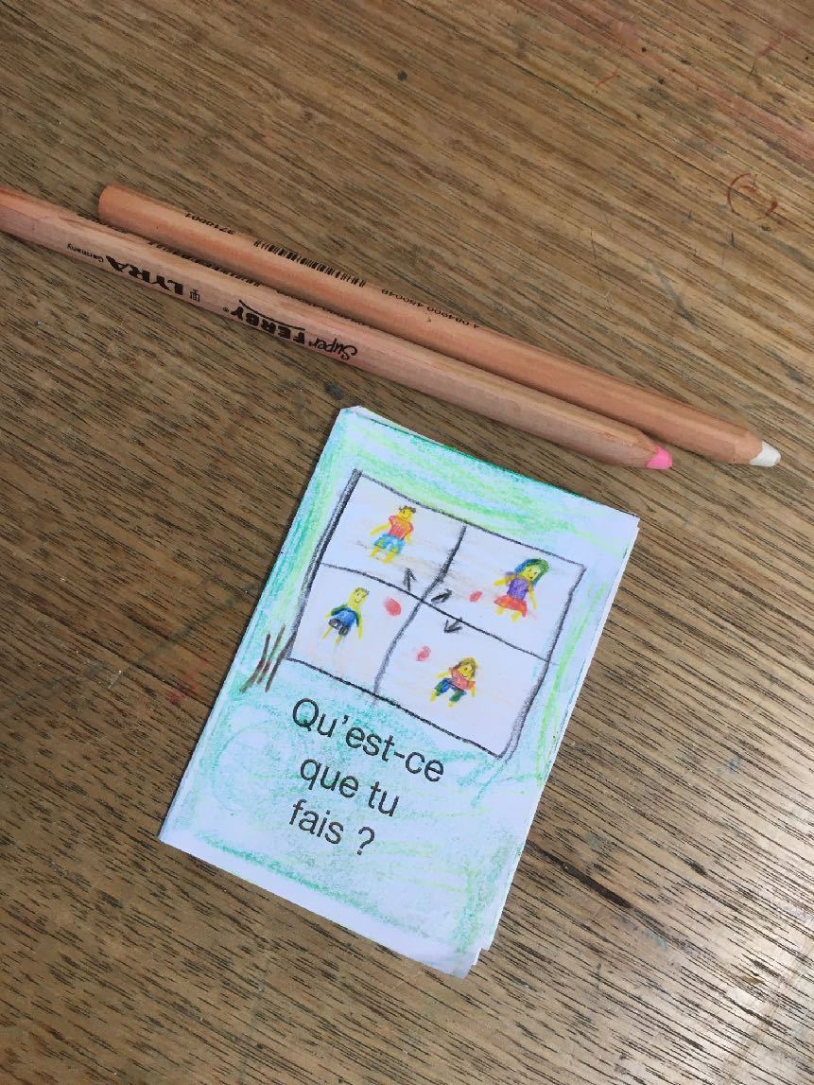
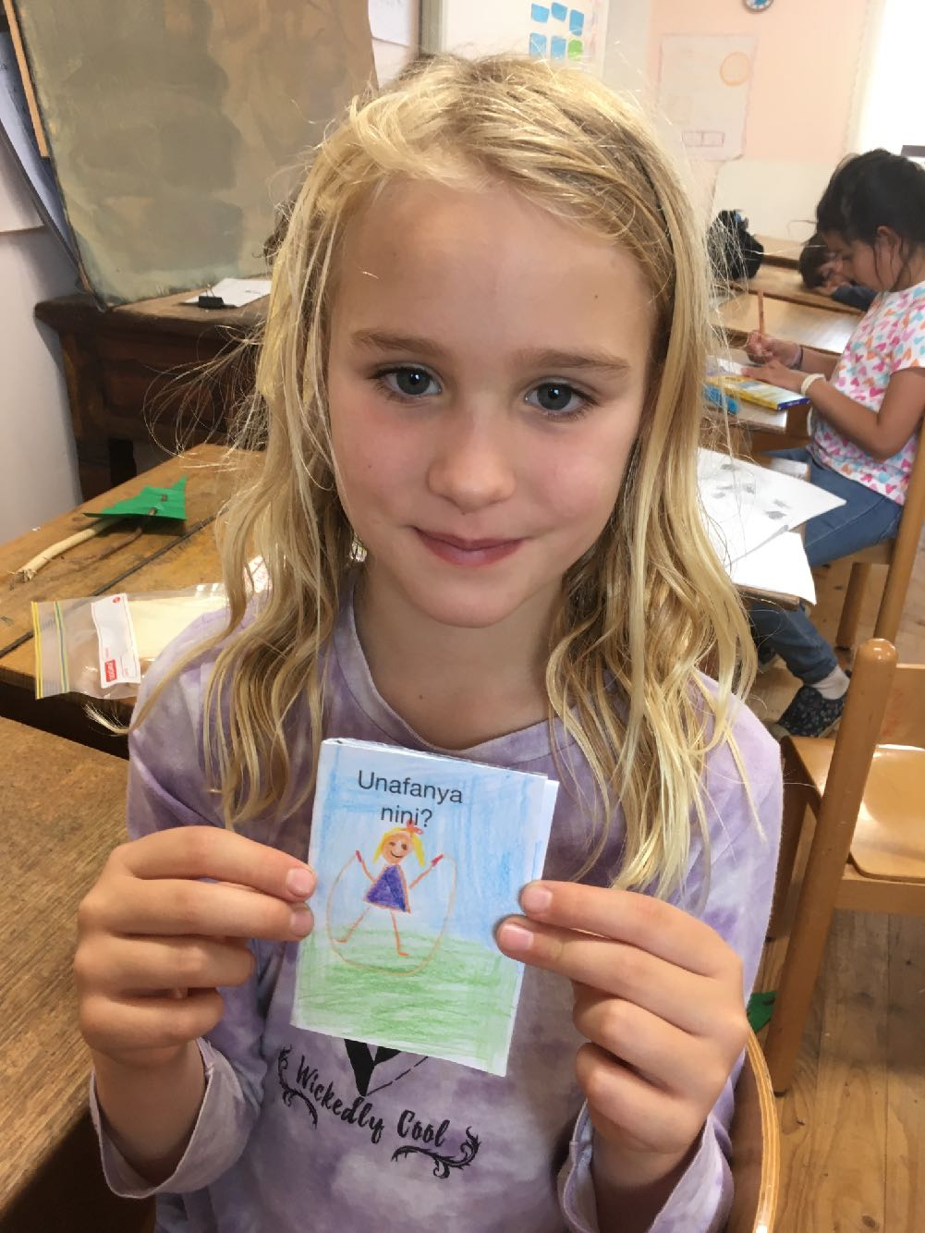
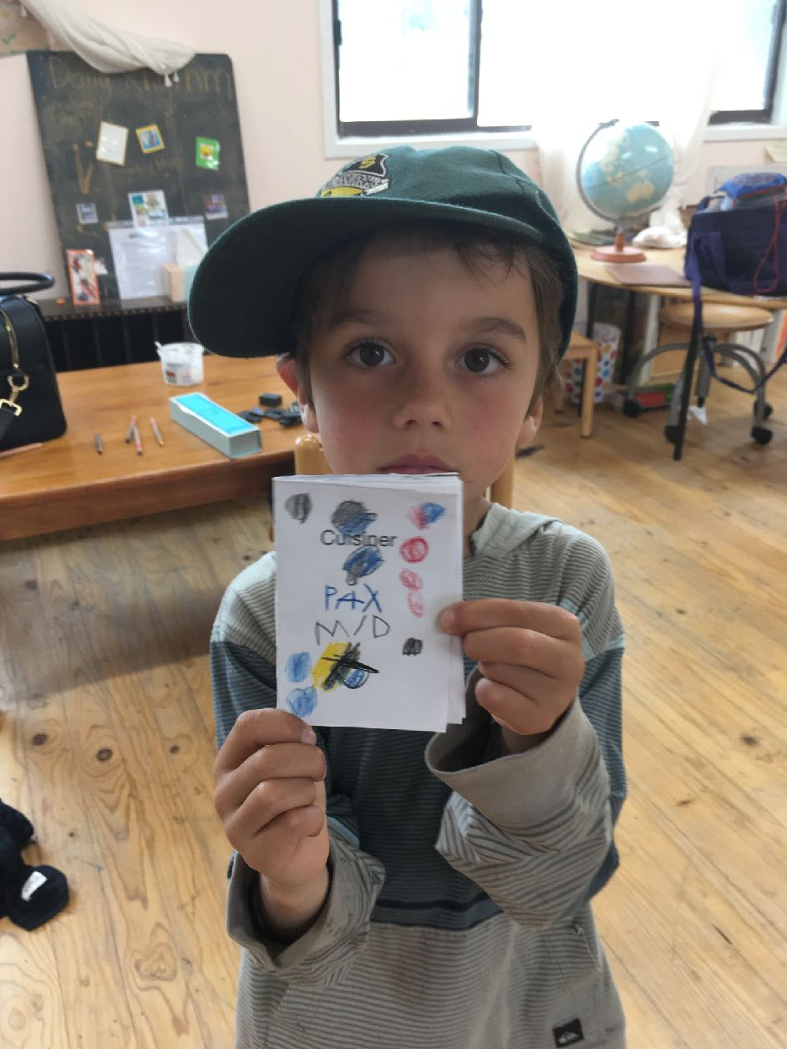
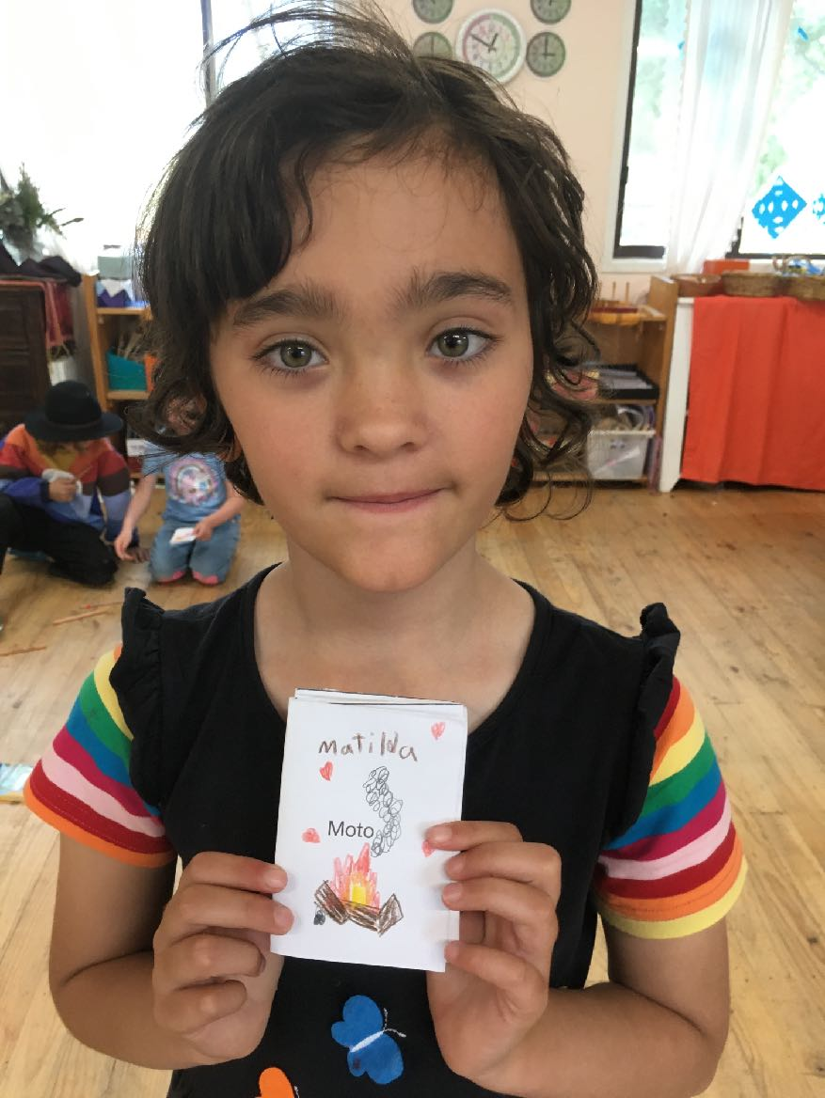
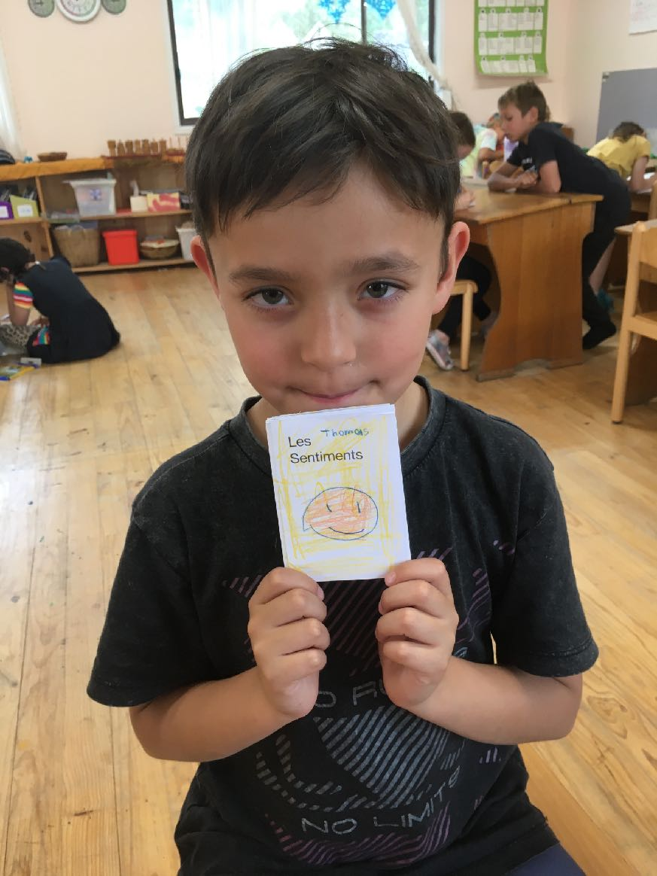

Slide 14
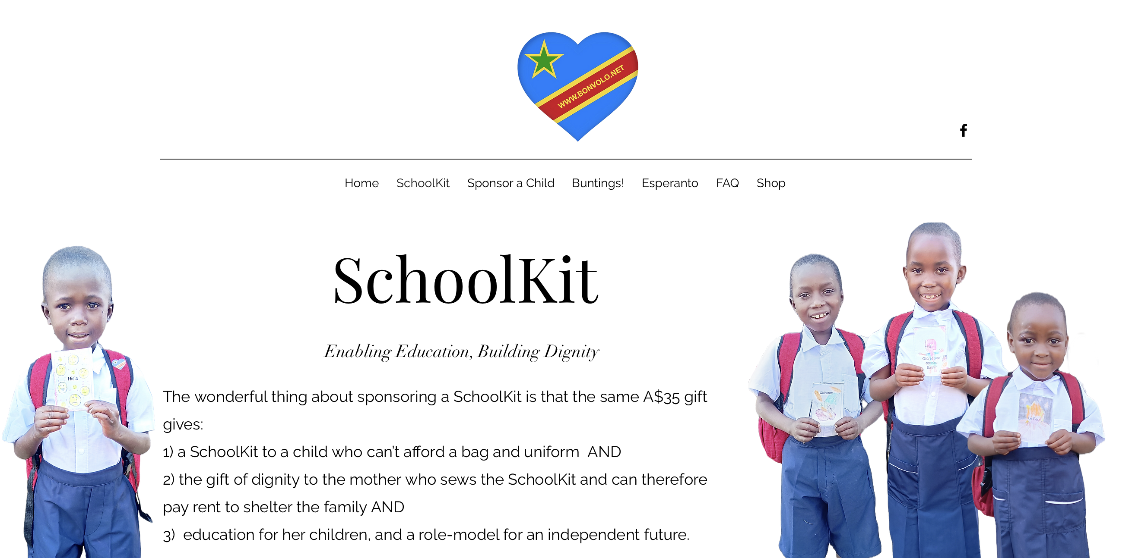

Slide 15
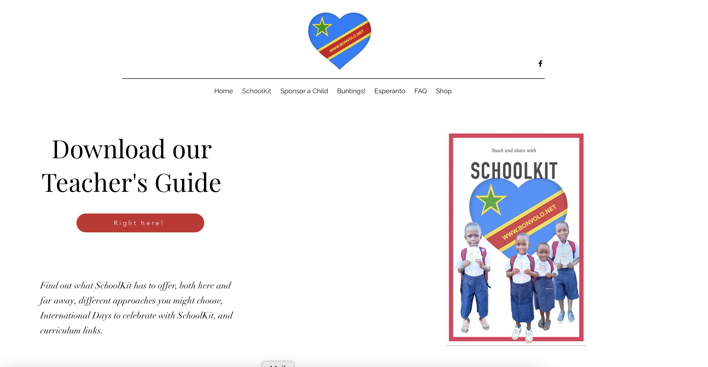

Slide 16
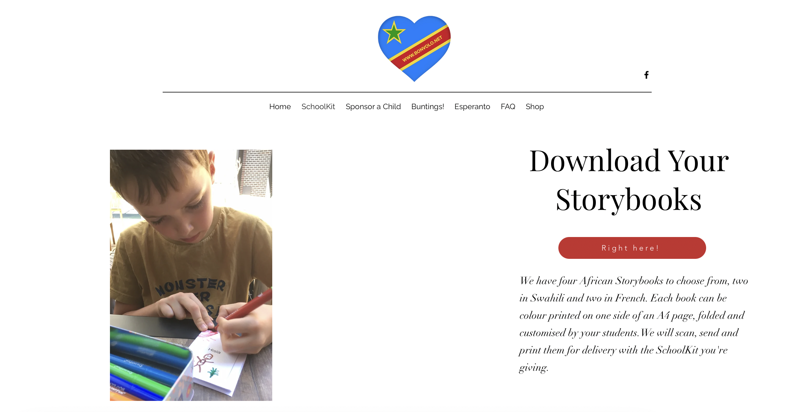

Slide 17
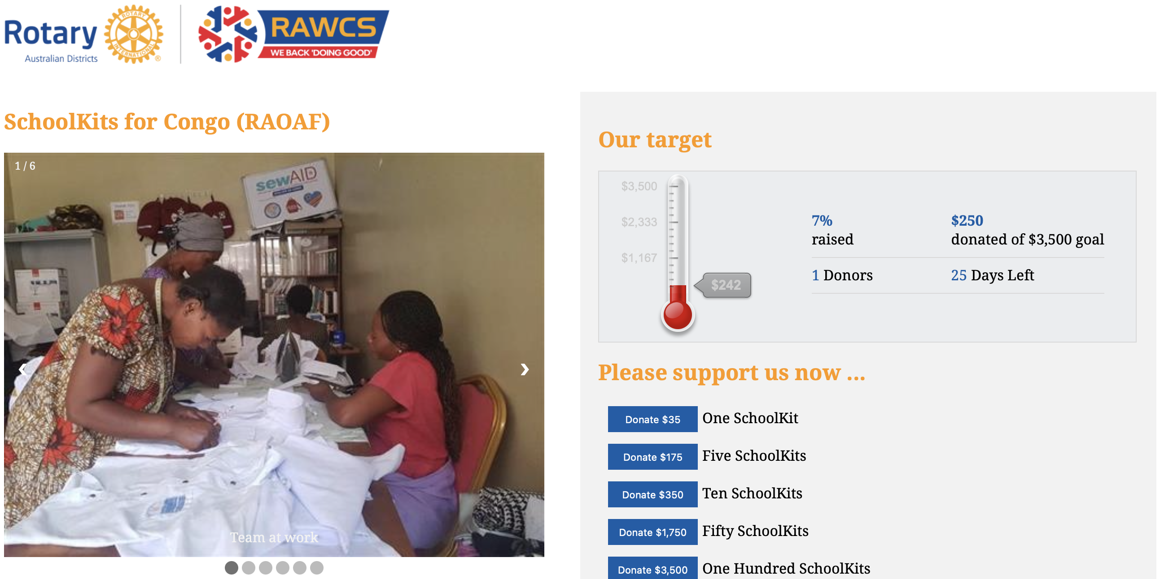

Slide 18
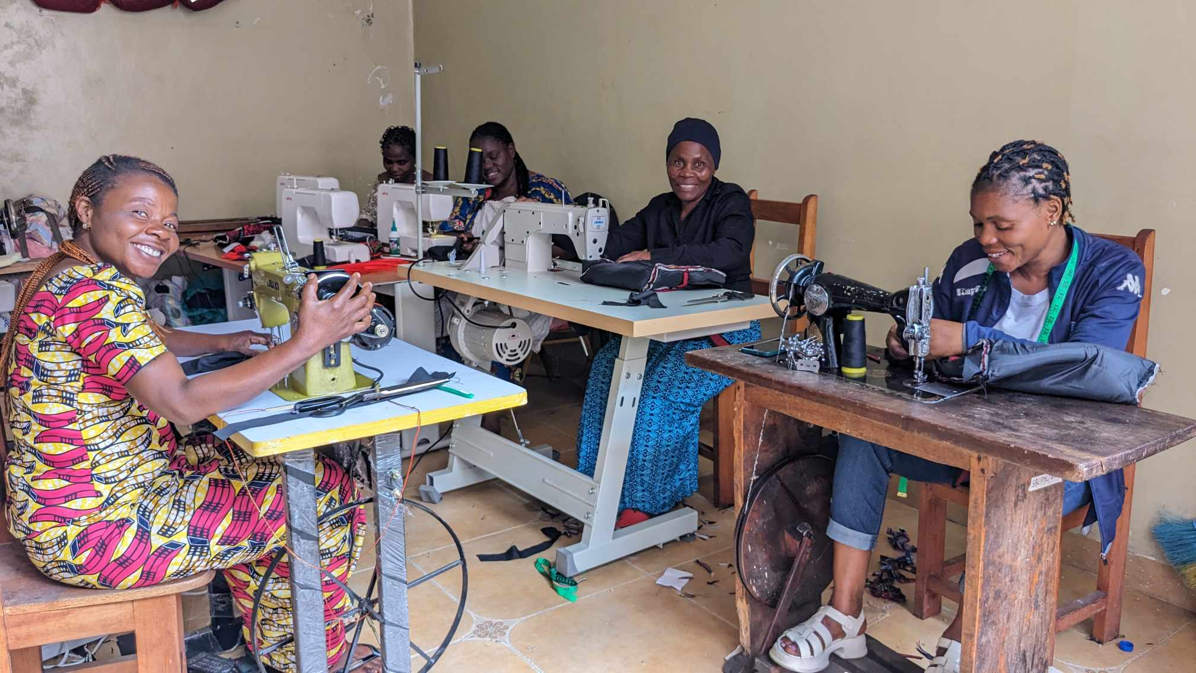

Slide 19
